Slide 1

Vel Tech Rangarajan Dr. Sagunthala R&D Institute of Science and Technology
School of Computing
Department of Computer Science and Engineering
10211CS224 / FULL STACK APPLICATION DEVELOPMENT (JAVA)
END SEMESTER PROJECT REVIEW
Date: 06-05-2026
Smart Campus Event Management System
SDG: SDG 9 – Industry, Innovation and Infrastructure
Presented By:
SAMEER TONDUR – VTU25541 – 23UECS0503.
Course Handling Faculty:
Dr. S . HEMAMALINI – M.E., Ph.D.,

Slide 2
INTRODUCTION
1
Background of the problem:
Many colleges and universities still manage events manually or through scattered systems like notices, WhatsApp groups, or spreadsheets. This leads to issues such as miscommunication, missed registrations, lack of centralized data, and difficulty in tracking participants or event details.
Why this project is important:
It helps automate event creation, registration, notifications, and participant tracking using modern web technologies and database systems. It improves communication and reduces manual workload for organizers.
Real-world relevance:
This system is widely applicable in educational institutions, corporate organizations, and communities where multiple events are conducted regularly. Similar systems are used in universities, tech fests, workshops, seminars, and conference management platforms.
Brief overview of the system:
A responsive web-based application that allows users (students and organizers) to view, register, and manage campus events.
2
3
4
5
6
7
8
9

Slide 3
PROBLEM STATEMENT
In many colleges, event management is handled manually or through scattered platforms, leading to poor communication, inefficient registration, data errors, and lack of centralized information. This makes it difficult for students to discover events and for administrators to manage them effectively.
The Smart Campus Event Management System solves these issues by providing a centralized, secure, and user-friendly platform for managing events, registrations, and communication in a streamlined and paperless manner.
1
2
3
4
5
6
7
8
9

Slide 4
OBJECTIVES
1
To design and develop a centralized system for managing events efficiently.
To provide a user-friendly interface for browsing and registering for events.
To enable organizers to create, update, and manage event details easily.
To automate processes like OTP verification, email notifications, and QR code generation.
To reduce manual work and improve overall system efficiency.
2
3
4
5
6
7
8
9

Slide 5
PROPOSED SYSTEM
Event management is often handled using manual or scattered systems.
Users face difficulty in finding and registering for events.
There is no centralized platform to manage event details efficiently.
Organizers struggle to track participants and update event information.
Existing systems do not provide smooth user experience.
There is a need for a system that ensures efficient event handling.
1
2
3
4
5
6
7
8
9

Slide 6
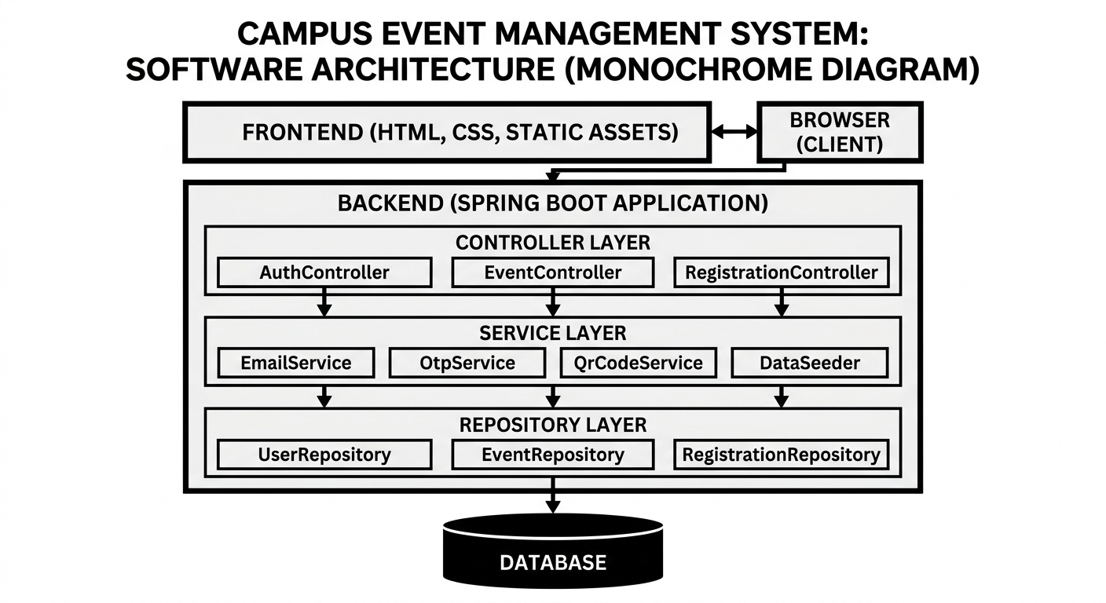
PROPOSED SYSTEM ARCHITECTURE
1
2
3
4
5
6
7
8
9

Slide 7
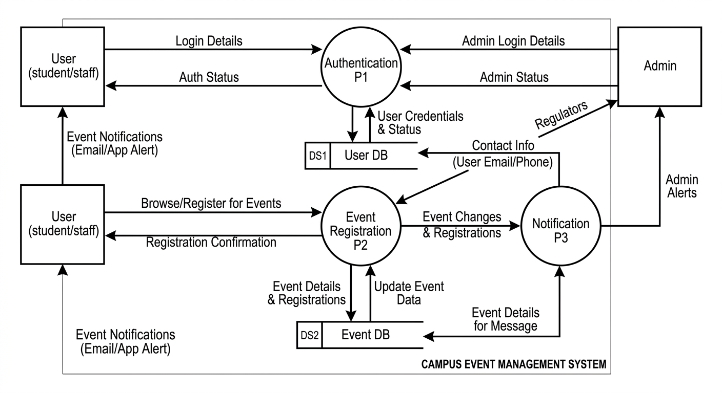
WORKFLOW
Dataflow diagram:
1
2
3
4
5
6
7
8
9

Slide 8
TECHNOLOGIES USED
Frontend:
1.HTML5
2.CSS3
3.Javascript
Backend:
1.Java Spring Boot
2.H2 Console
Tools:
1.VS-Code
Software Requirements:
1.Windows
2. Web Browser
1
2
3
4
5
6
7
8
9

Slide 9
MODULE DESCRIPTION
Module 1: Event Management:
Display Events Dynamically.
Organize Events By Category.
View Event Details.
Module 2: Registration Management:
Register For Events.
Cancel Registration.
View Registered Events.
Module 3: Data Persistence Module:
Stores Event & User Data in H2 Console.
Retrieves Data After Refresh.
Module 4: Notification Module:
Send Confirmation Email After Registration.
Notify Users About Event Updates.
1
2
3
4
5
6
7
8
9

Slide 10
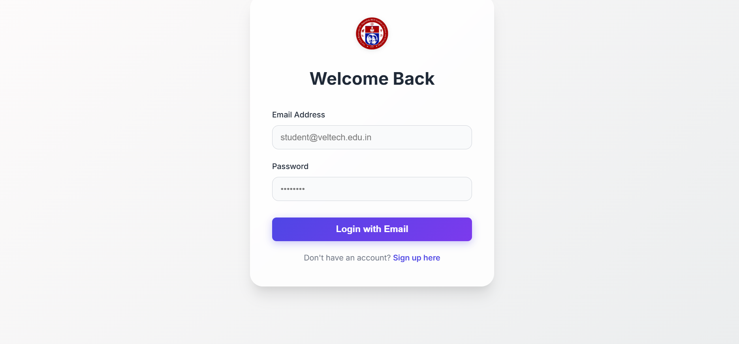
IMPLEMENTATION SCREENSHOTS
Login Page:
This is the page where user and admin can login into the website by entering the ID,password.
1
2
3
4
5
6
7
8
9

Slide 11
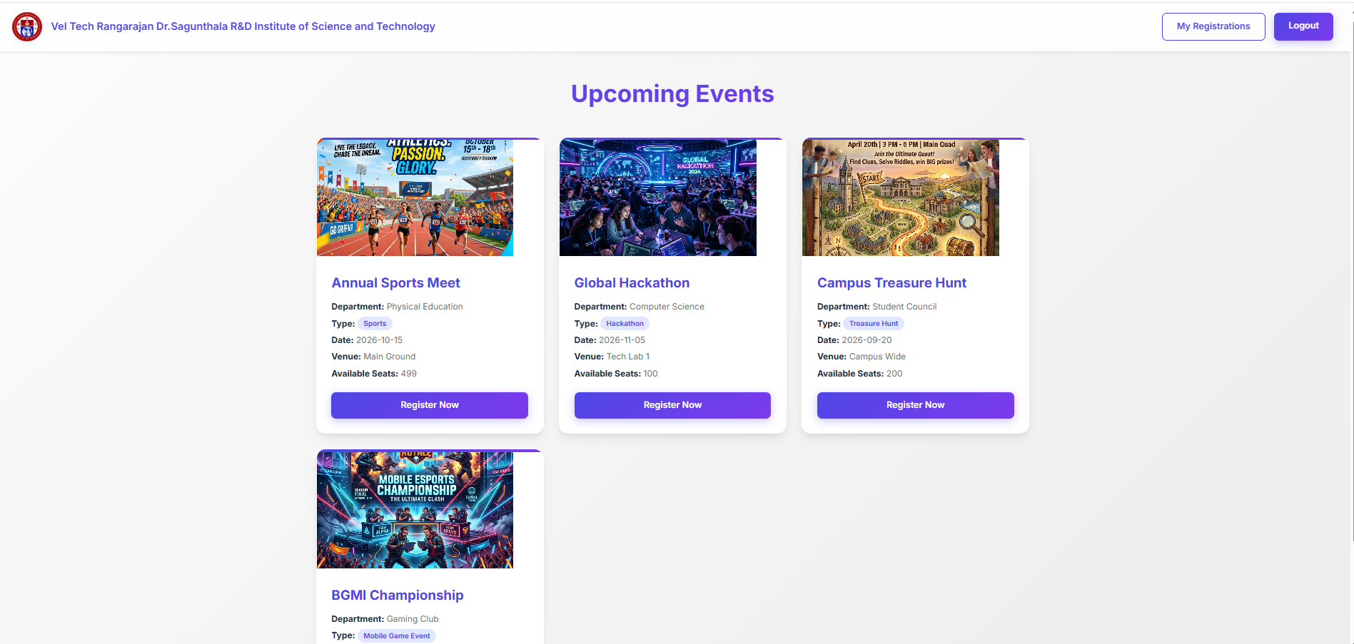
IMPLEMENTATION SCREENSHOTS
Home Page :
This is the page where the events are assembled and we can register them.
1
2
3
4
5
6
7
8(A)
9

Slide 12
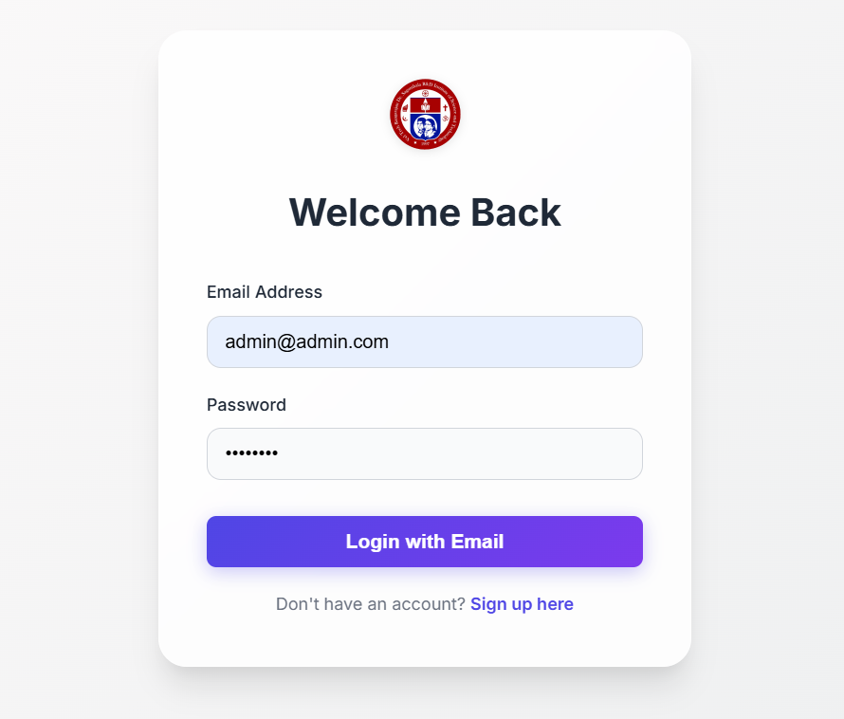
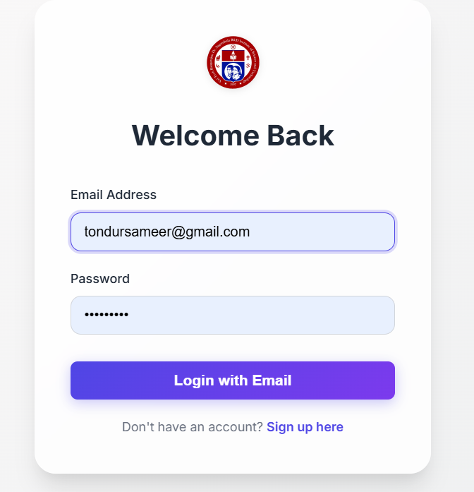
IMPLEMENTATION SCREENSHOTS
Admin Login Page
User Login Page
1
2
3
4
5
6
7
8(B)
9

Slide 13
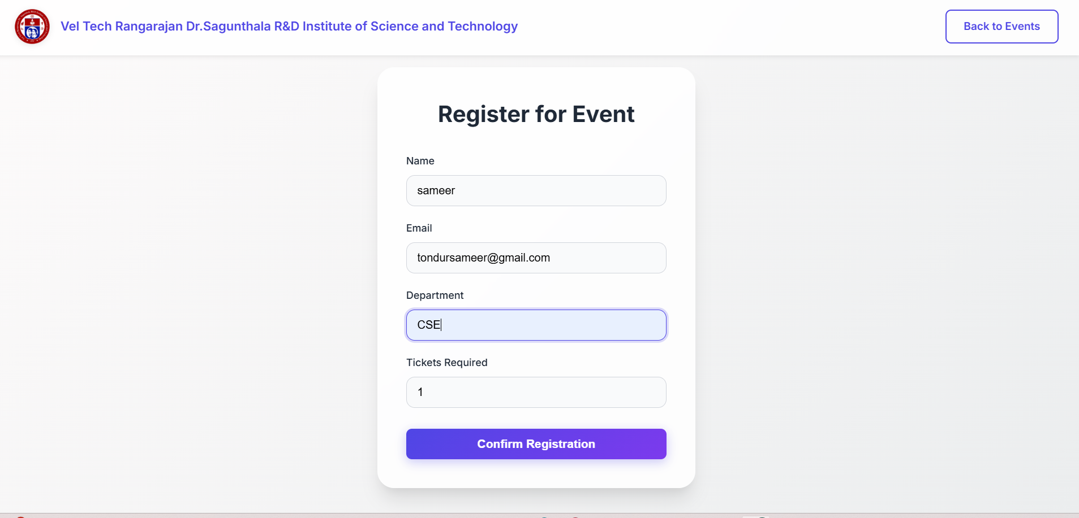
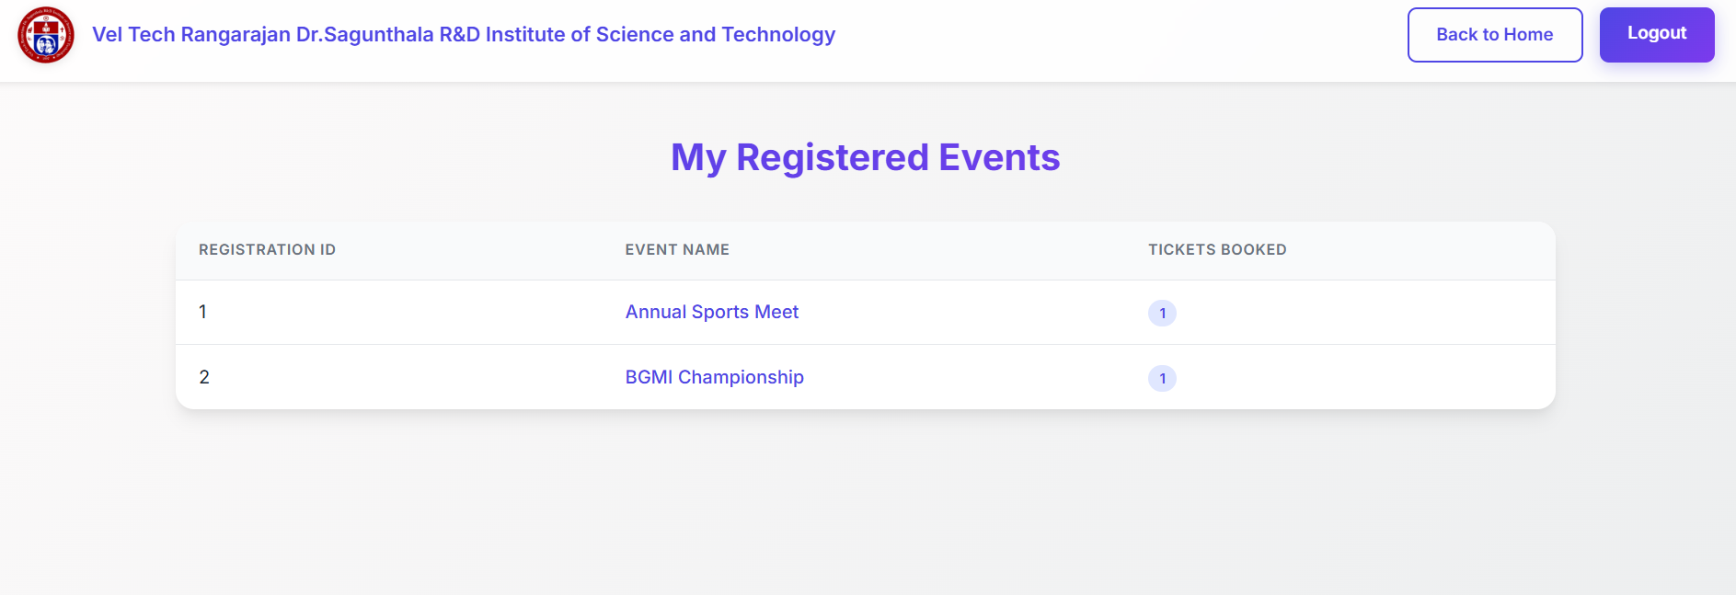
IMPLEMENTATION SCREENSHOTS
1
2
3
4
5
6
7
8(C)
9

Slide 14
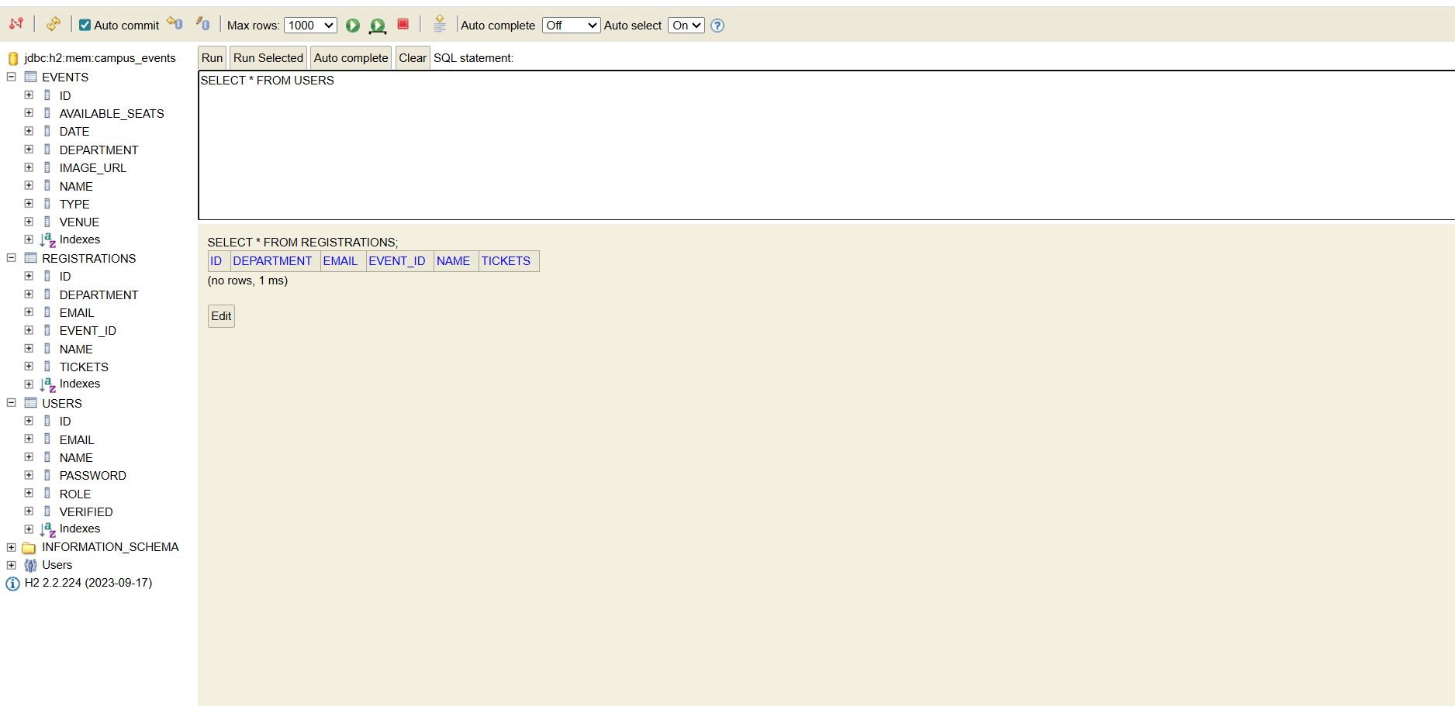
IMPLEMENTATION SCREENSHOTS
Database Screenshot
All Tables screenshot with sample data
1
2
3
4
5
6
7
8(C)
9

Slide 15
ADVANTAGES & LIMITATIONS
Advantages:
Easy event registration process.
Data persistence using H2 Database.
Real-time updates for users.
Improves coordination and reduces manual work.
User-friendly and responsive interface.
Limitations:
Limited scalability for large-scale usage.
Basic notification system email only.
Less support for advanced analytics features.
Data security depends on implementation.
1
2
3
4
5
6
7
8
9

Slide 16
Thank you

